Slide 1
EMPLOYEE DATA ANALYSIS USING EXCEL
NAME: S.DINESH KUMAR
REGISTER NO: autunm110312201237
5576FDDA2D053B4AFD440A7ECBFCE7ED
DEPARTMENT: III B.Com General
COLLEGE: DRBCCC HINDU COLLEGE, PATTABIRAM

Slide 2
Project Title
Employee Gender Analysis Using Excel

Slide 3

Agenda
Problem Statement
Project Overview
End Users
Our Solution & Preposition
Dataset Description
Modelling Approach
Results & Discussion
Conclusion

Slide 4

Problem Statement
To analyze gender dynamics, identify areas for improvement, and inform strategies to foster a more inclusive, equitable, and diverse work environment.
To promote gender equality and diversity by examining representation, equality, and inclusion across the organization.

Slide 5

Project Overview
Objective: Analyze gender dynamics for inclusivity & diversity
Scope: Distribution, representation, equality & inclusion
Methodology: HR data analysis & visualization
Outcome: Insights & recommendations for diversity initiatives

Slide 6

Who are end users?
1. HR Department: To inform recruitment, retention, and diversity initiatives
2. Management Team: To make data-driven decisions on promotions, talent development, and policy changes.
3.Diversity and Inclusion Committee: To monitor progress and identify areas for improvement.
4. Organizational Leadership: To understand gender dynamics and develop strategies for a more inclusive workplace.
5. Department Heads: To identify gender gaps in their teams and develop targeted solutions.
6. Employee Resource Groups (ERGs): To advocate for gender equality and inform
7. Researchers and Analysts: To study gender trends and benchmark against industry standards.
8. Compliance Officers: To ensure adherence to gender equality laws and regulations.

Slide 7

Our solution & value preposition
Downloaded dataset from dashboard
Utilized Excel tools for in-depth analysis
Filtering: Identified specific trends and patterns
Conditional Formatting: Highlighted key insights and disparities
Formulas: Calculated metrics and ratios
Visualized findings through
Charts: Illustrated gender distribution and trends
Graphs: Showcased key insights and conclusions
By leveraging Excel's powerful features, you transformed raw data into actionable insights, providing a comprehensive understanding of employee gender dynamics.

Slide 8

Dataset Description
This dataset contains a subset of employee information, carefully selected from a larger database. The five key columns included in this analysis are:
1. First Name: The employee's given name
2. Last Name: The employee's surname
3. Gender: The employee's self-identified gender
4. User ID: A unique identifier assigned to each employee
5. Employee Type: The employee's designation or job category.
These columns provide a comprehensive overview of the employee demographic, enabling a focused analysis of gender dynamics within the organization.

Slide 9

Modelling Approach
Step 1: Data Selection
- Selected a subset of relevant columns from the larger dataset:
- First Name
- Last Name
- Gender
- User ID
- Employee Type
Step 2: Data Filtering
- Applied filters to focus on specific segments of the data:
- Filtered by gender to analyze male and female employees separately
- Filtered by employee type to analyze different job categories
Step 3: Data Formatting
- Used conditional formatting to highlight key insights:
- Highlighted gender disparities in employee distribution
- Highlighted trends in employee type and gender

Slide 10

Modelling Approach
Step 4: Data Analysis* - Used formulas to calculate metrics and ratios: - Calculated gender ratios across employee types - Calculated percentages of male and female employees in each category Step 5: Data Visualization* - Created charts and graphs to illustrate findings: - Bar charts to show gender distribution across employee types - Pie charts to show percentage breakdown of male and female employees Step 6: Insight Generation* - Analyzed the visualized data to draw conclusions and identify trends: - Identified areas with significant gender disparities - Identified trends in employee type and gender distribution This step-by-step process outlines the modeling approach used to analyze and visualize the employee gender data, providing a clear understanding of the methodology used to generate insights.

Slide 11
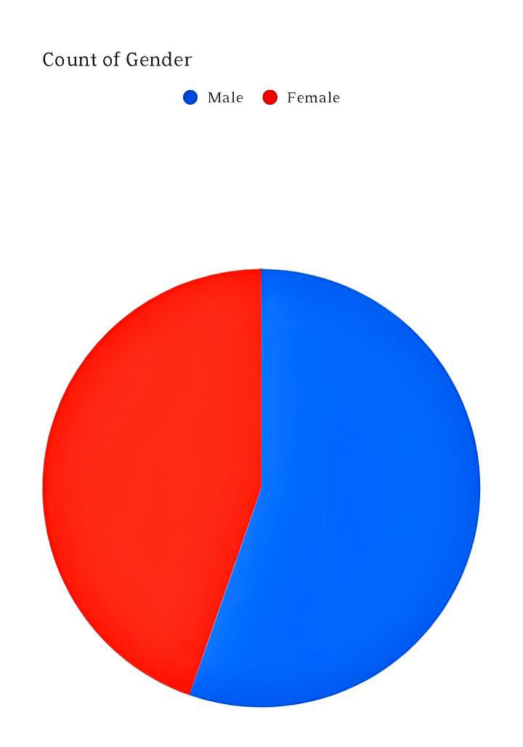
Result
Employee gender analysis by pie chart

Slide 12
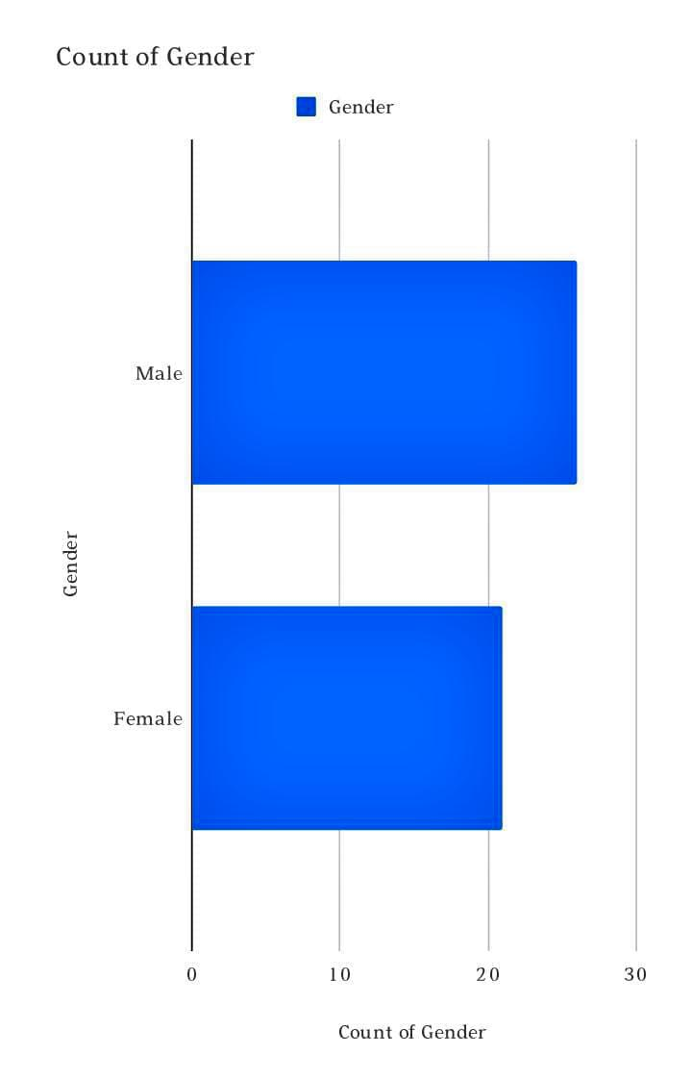
Result
Employee gender analysis by bar diagram

Slide 13

Conclusion
This Employee Gender Analysis reveals valuable insights into our organization’s gender dynamics, highlighting areas of strength and opportunities for improvement. Key findings include gender disparities in certain roles and departments, underrepresentation of female leaders, and opportunities for growth in diversity initiatives. Recommendations include targeted recruitment, mentorship programs, and ongoing monitoring to foster a more inclusive workplace.
This analysis reveals gender disparities and opportunities for growth. Recommendations include targeted recruitment, mentorship programs, and ongoing monitoring to foster a more inclusive workplace.

